Slide 1

Covid-19 impact On paNcreaTic cAncer Care paThway
A National, Pan-Specialty, Multi-Centre Study of the Impact of SARS-CoV-2 on New Diagnosed Pancreatic Cancer Treatment

Slide 2

What is CONTACT?
Covid-19 impact On paNcreaTic cAncer Care paThway
A national, pan-specialty, multi-centre audit
Aim
To assess the impact of SARS-CoV-2 on new diagnosed pancreatic cancer treatment
Design
Compare pandemic patient cohort against pre-pandemic patient cohort
6-month and 12-month follow-up periods

Slide 3
Possible impact of COVID for pancreatic cancer patients
The SARS-CoV-2 pandemic has had an unprecedented impact on healthcare systems, with near-paralysis of non-COVID-related services during the peak of the pandemic.
?
Disease progression
Delays in diagnosis
No treatment
Modified chemotherapy regimens

Slide 4
Aims & Objectives
Aim
Assess the impact of SARS-CoV-2 on new diagnosed pancreatic cancer treatment
Primary Objective
Assess the rate of receipt of chemotherapy at 6- and 12-months from diagnosis during the peak of the SARS-CoV-2 pandemic, compared to pre-pandemic rates
Secondary Objectives
Assess 6- and 12-month outcomes comparing pre-pandemic to pandemic cohorts against audit standards (next slide)
overall mortality rate of disease progression
changes to treatment offered time to diagnosis and treatment
chemotherapy regimen received radiotherapy regimens received
rates of surgery and unintended bypass

Slide 5
Methods
Centres
All centres treating pancreatic cancer patients (specialist and non-specialist) are eligible to join.
As the majority of patients are treated in non-specialist centres (e.g. unresectable disease, decompression, and delivery of chemotherapy)
Trainee-network led design
Sharing the workload across referring networks
Patients only being entered at the site they first present to, evenly distributing the number of patients entered at each hospital across the referring network.
We estimate each centre will enter 5-20 patients per study time period in an average sized hospital

Slide 6
Inclusion and Exclusion Criteria
Inclusion Criteria
All adult patients newly diagnosed with suspected pancreatic cancer (presenting during the ‘patient entry period’ defined below) i.e. those discussed at MDT during the patient entry period as a new presentation/diagnosis of suspected pancreatic cancer.
Exclusion Criteria
Patients who initially presented to a different hospital
  The case should be captured and recorded by the hospital where the patient initially presented

Slide 7
Patient Entry
Patient Entry Period
All patients fulfilling the inclusion criteria presenting within the following time periods:
Pre-pandemic cohort: 7th January 2019 to 3rd March 2019 (8 weeks).
Pandemic cohort: 16th March 2020 to 10th May 2020 (8 weeks).
Follow-up
6-month and 12-month follow-up

Slide 8
Data Collection
Each site will need to register CONTACT study as an audit with their Hospital’s Research and Audit Office
All data will be available from routinely collected patient records, and no patients will be contacted
No identifiable data will be entered onto the centrally held REDCap database
Data collection will cover the following elements measured against the audit standards:
Demographics: Age, co-morbidity (Charlson Comorbidity Index) & deprivation index.
Diagnosis: Date of presentation, diagnostic investigations.
Treatment Status: 6- and 12-month follow-up: Neo-adjuvant chemotherapy (type, number of cycles), surgery (resection or bypass), adjuvant chemotherapy (type, number of cycles), palliative chemotherapy (type, number of cycles), recurrence post-operatively (date, local/metastatic), survival, COVID status.

Slide 9
Data Collection Flowchart
Register Study with Local Trust Research and Audit Research team
Once study is registered, All 6 month data can be entered onto Redcap for both the pre-pandemic and pandemic patient cohort
12 month data can be completed now for pre-pandemic cohort, and completed in May 2021 for pandemic cohort
Audit standards:
NICE Guidelines for Pancreatic Cancer
CONSENSUS STATEMENT: Considerations for the treatment of pancreatic cancer during the COVID-19 pandemic: the UK consensus position

Slide 10
Key information
Authorship:
The study will use a collaborative authorship model, the ‘The CONTACT study group’. All collaborators will be acknowledged according to their input to the study.
Study documents:
Found on our webpage: https://www.psgbi.org/contact-study/
Registration:
We welcome involvement from oncology, surgery, gastroenterology, palliative care/CNS and up to two trainees at each site. We require that there is one lead consultant and one lead trainee at each site:
The link to the registration form: https://redcap.link/contactaudit

Slide 11
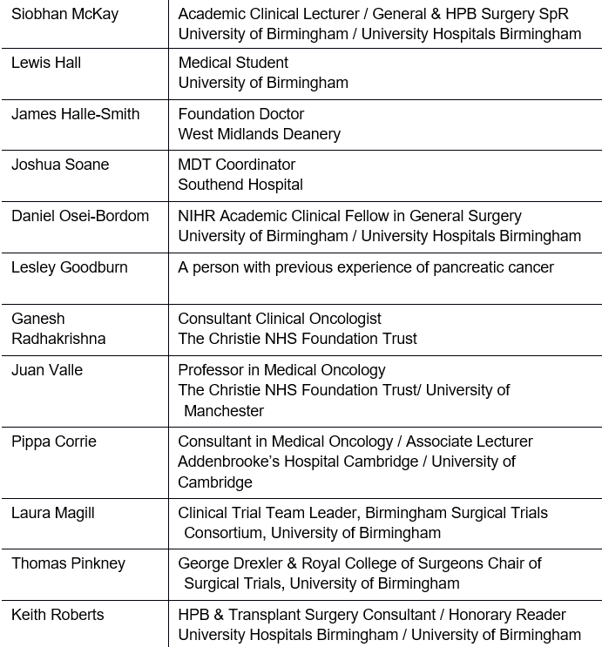
Steering Committee

Slide 12

Study
The most comprehensive evaluation of COVID upon pancreatic cancer care in the UK
Covid-19 impact On paNcreaTic cAncer Care paThway
Open to All UK hospitals with an UGI/HPB MDT
More info: https://www.psgbi.org/contact-study/
Sign-up now: https://redcap.link/contactaudit

